Slide 1
CEL and CEA summary

Slide 2
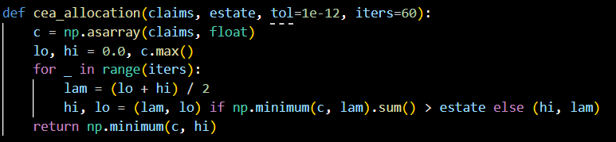
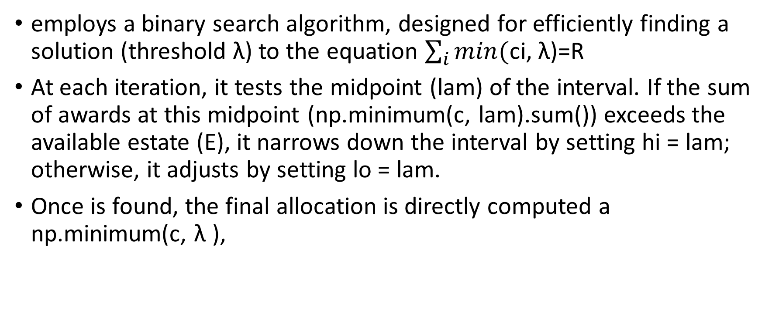
CEA
employs a binary search algorithm, designed for efficiently finding a solution (threshold λ) to the equation $\sum_{i}{min(}$ci, λ)=R
At each iteration, it tests the midpoint (lam) of the interval. If the sum of awards at this midpoint (np.minimum(c, lam).sum()) exceeds the available estate (E), it narrows down the interval by setting hi = lam; otherwise, it adjusts by setting lo = lam.
Once is found, the final allocation is directly computed a np.minimum(c, λ ),

Slide 3
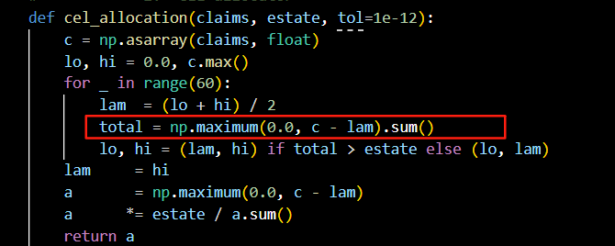
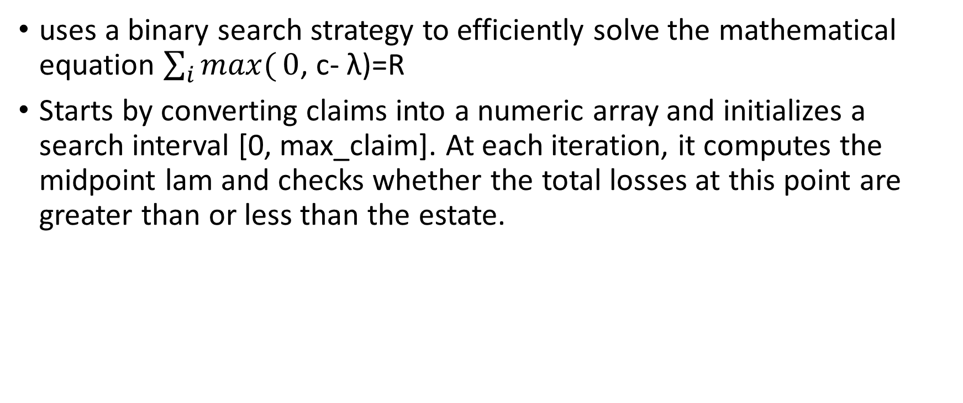
CEL
uses a binary search strategy to efficiently solve the mathematical equation $\sum_{i}{max(}0$, c- λ)=R
Starts by converting claims into a numeric array and initializes a search interval [0, max_claim]. At each iteration, it computes the midpoint lam and checks whether the total losses at this point are greater than or less than the estate.

Slide 4
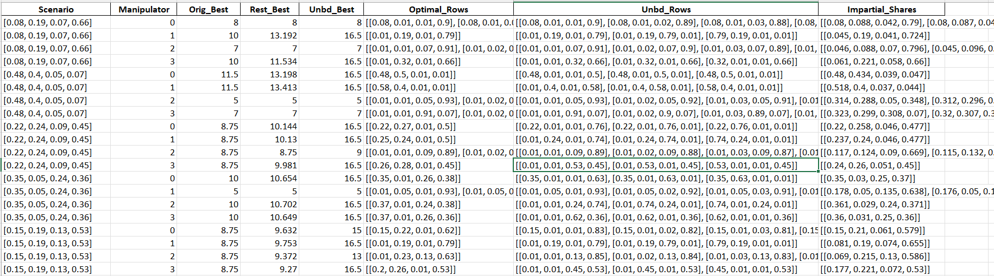
E=35

Slide 5
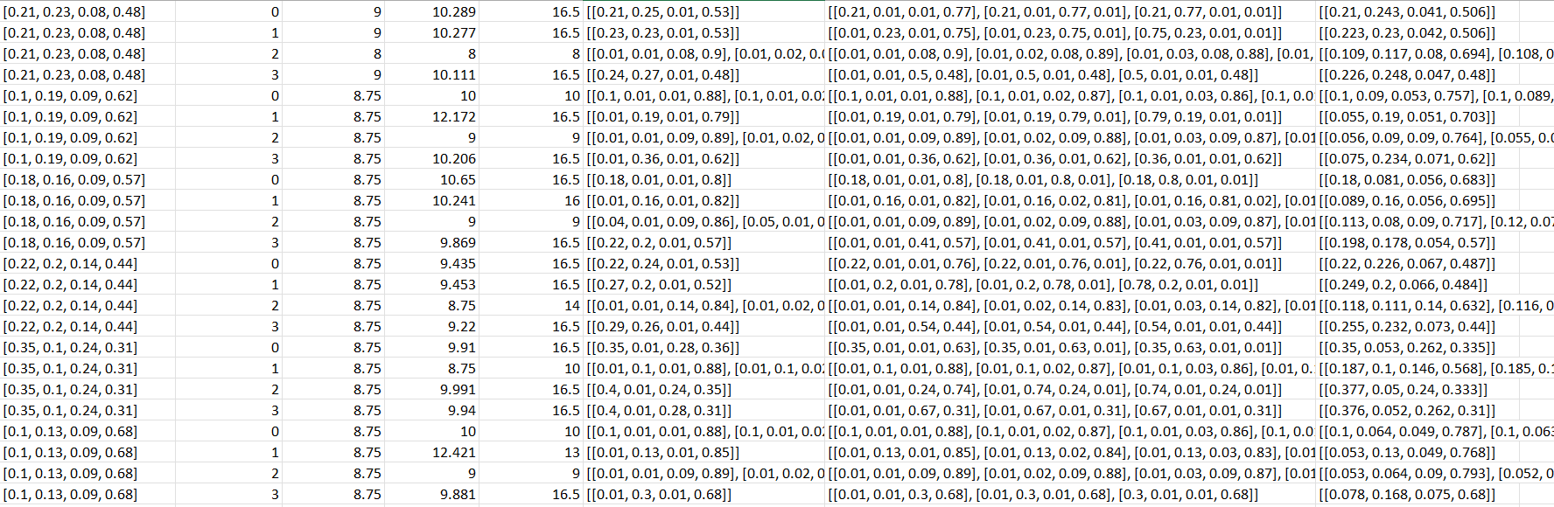

Slide 6
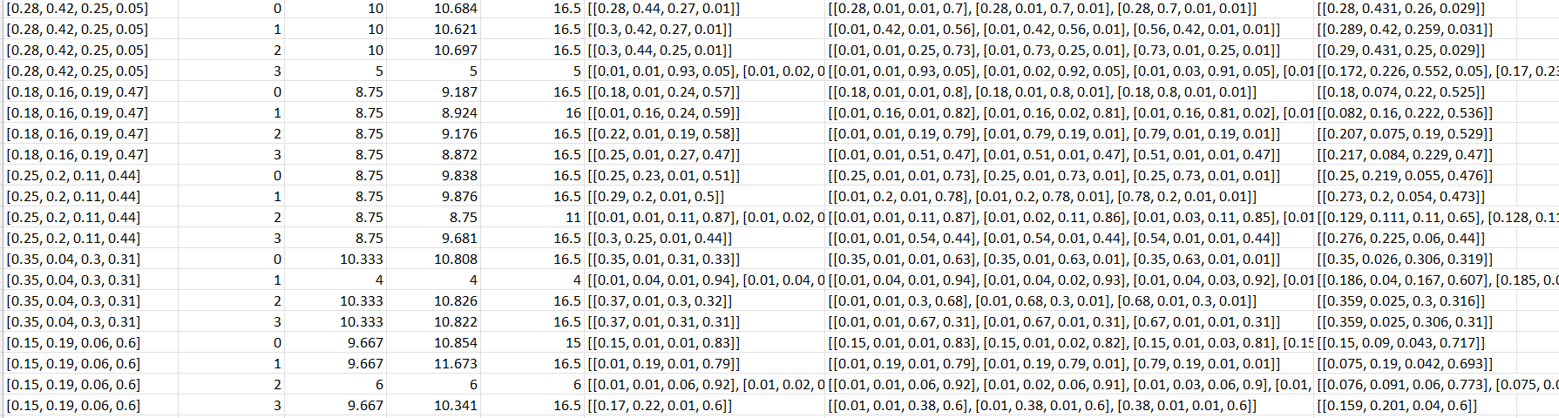

Slide 7
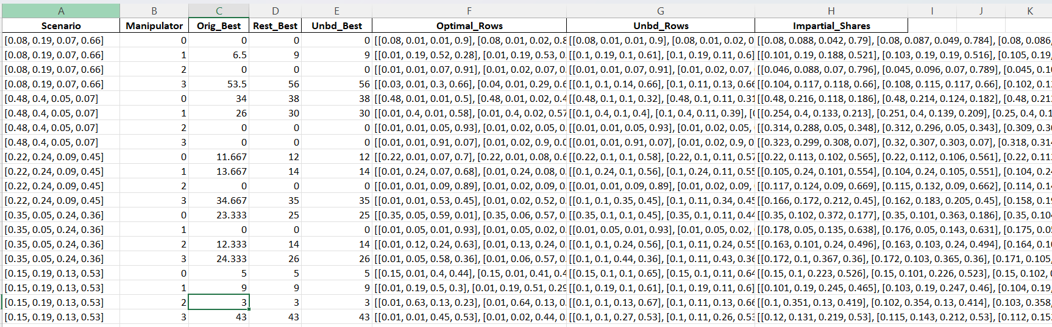
CEL E=60

Slide 8
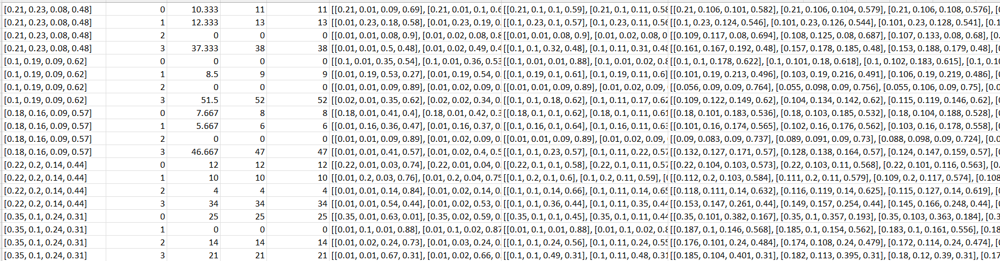

Slide 9
